Slide 1
PLASMA DONOR APPLICATION
ABSTRACT & INTRODUCTION

Slide 2
TEAM DETAILS
TEAM ID : PNT2022TMID05166
COLLEGE : PSNA COLLEGE OF ENGINEERING AND TECHNOLOGY
DEPARTMENT : ELECTRONICS & COMMUNICATION ENGINEERING
TEAM LEADER : CINTHAMANI KN
TEAM MEMBER : BRINDHA V
TEAM MEMBER : BRUNISHA P
TEAM MEMBER : DIVYADHARSHINI R

Slide 3
ABSTRACT
A plasma is a liquid portion of the blood, over 55% of human blood is plasma. Plasma is used to treat various infectious diseases and it is one of the oldest methods known as plasma therapy. Plasma therapy is a process where blood is donated by recovered patients in order to establish antibodies that fights the infection. In this project plasma donor application is being developed by using AWS services. The services used are AWS Lambda, API gateway, DynamoDB, AWS Elastic Compute Cloud with the help of these AWS services, it eliminates the need of configuring the servers and reduces the infrastructural costs associated with it and helps to achieve serverless computing. For instance, during COVID 19 crisis the requirement for plasma increased drastically as there were no vaccination found in order to treat the infected patients, with plasma therapy the recovery rates where high but the donor count was very low and in such situations it was very important to get the information about the plasma donors. Saving the donor information and notifying about the current donors would be a helping hand as it can save time and help the users to track down the necessary information about the donors.

Slide 4










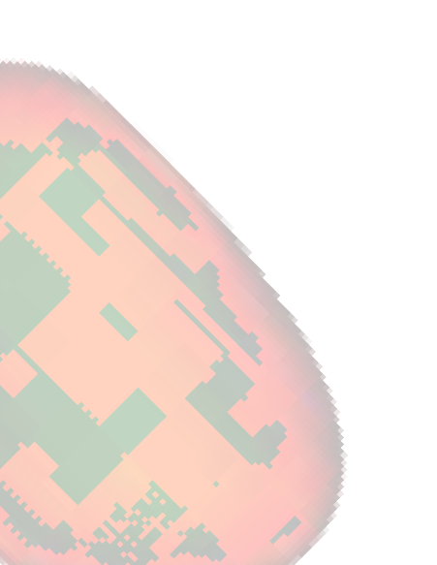



INTRODUCTION
Conventionally, when a patient needs blood, he/she has to contact a blood bank or a compatible blood group of a donor in their circle, family, and friends. However, it is difficult to find suitable donor within a limited group of people in a given time. In addition, there is no guarantee that blood banks will have compatible blood group in stock. There is also steady increase in blood donation requests posts in social networking sites (like Facebook, twitter, Instagram, etc.) requesting for donation. Ease of access, requirements of blood, and the blood donation statistics are taken into consideration while researching the topic. There is a steady need for blood and blood components (red blood cells, blood plasma, platelets). Every minute of every day someone is in need for blood, however as e.g., in Canada , only 1 in 60 Canadians gave blood last year, when almost 1 of every 2 Canadians is eligible to donate. 52% of Canadians say they or a family member have needed blood or blood products. The blood donation rate in high-income countries is 33.1 donations per 1,000 people; 11.7 donations in middle-income countries and 4.6 donations in low-income countries . As a result, finding blood donor is becoming very difficult in almost every country.

Slide 5






WORKFLOW OF THE PROJECT
During the COVID 19 crisis, the requirement of plasma became a high priority and the donor count has become low. Saving the donor information and helping the needy by notifying the current donors list, would be a helping hand. In regard to the problem faced, an application is to be built which would take the donor details, store them and inform them upon a request.
The user interacts with the application.
Registers by giving the details as a donor.
The database will have all the details and if a user posts a request then the
concerned blood group donors will get notified about it.

Slide 6
REQUIREMENTS
SOFTWARE REQUIRED:
Python
Flask
Docker
SYSTEM REQUIRED:
8GB RAM
Intel Core i3
OS-Windows/Linux/MAC
Laptop or Desktop

Slide 7
FUTURE ENHANCEMENTS
Upgrading the UI that is more user-friendly which will help many users to access the website and also ensures that many plasma donors can be added into the community. Using elastic load balancer, it helps to handle multiple requests at the same time which will maintain the uptime of the website with negligible downtime.

Slide 8
CONCLUSION
The efficient way of finding plasma donor for the infected people is implemented using the plasma donor website that is hosted on Aws platform. To ensure the smooth functioning of the website operations. I have hosted the website in aws platform to make sure the operations are running successfully Aws lambda function is used and to deploy the application AWS EC2 service is used.

Slide 9
REFERENCES
1.Safe blood and blood products. Module 1: Safe blood donation. Geneva: World Health Organization; 2002. [17 August 2012]. http://www.who.int/bloodsafety/transfusion_services/bts_learningmaterials/en/index.html. 2.Blood donor selection. Guidelines on assessing donor suitability for blood donation.
Annex
3.Aide-mémoire. Blood safety. Geneva: World Health Organization; 2002. [17 August 2012].
http://www.who.int/bloodsafety /publications/who_bct_02_03/en/index.html. 4.WHO/IFRC. Towards 100% voluntary blood donation: A global framework for action. Geneva: World Health Organization; 2010. [17 August 2012]. http://www.who.int/bloodsafety/publications /9789241599696/en/ [PubMed]
5.The Melbourne Declaration on 100% voluntary non-remunerated donation of blood and blood components. Geneva: World Health Organization; 2009. [17 August 2012]. http://www
.who.int/worldblooddonorday/Melbourne_Declaration_VNRBD_2009.pdf.

Slide 10
THANK YOU!

